Slide 1
Fundamentals of Information Systems, Sixth Edition
Chapter 1
An Introduction to Information Systems in Organizations

Slide 2
Principles and Learning Objectives
The value of information is directly linked to how it helps decision makers achieve the organization’s goals
  Distinguish data from information and describe the characteristics used to evaluate the quality of data
Fundamentals of Information Systems, Sixth Edition

Slide 3
Principles and Learning Objectives (continued)
Knowing the potential impact of information systems and having the ability to put this knowledge to work can result in a successful personal career, organizations that reach their goals, and a society with a higher quality of life
  Identify the basic types of business information systems and discuss who uses them, how they are used, and what kinds of benefits they deliver
Fundamentals of Information Systems, Sixth Edition

Slide 4
Principles and Learning Objectives (continued)
System users, business managers, and information systems professionals must work together to build a successful information system
  Identify the major steps of the systems development process and state the goal of each
Fundamentals of Information Systems, Sixth Edition

Slide 5
Principles and Learning Objectives (continued)
The use of information systems to add value to the organization can also give an organization a competitive advantage
  Identify the value-added processes in the supply chain and describe the role of information systems within them
  Identify some of the strategies employed to lower costs or improve service
  Define the term competitive advantage and discuss how organizations are using information systems to gain such an advantage
Fundamentals of Information Systems, Sixth Edition

Slide 6
Principles and Learning Objectives (continued)
IS personnel is a key to unlocking the potential of any new or modified system
  Define the types of roles, functions, and careers available in information systems
Fundamentals of Information Systems, Sixth Edition

Slide 7
Why Learn About Information Systems in Organizations?
Information systems used by:
  Sales representatives
  Managers
  Financial advisors
Information systems:
  Indispensable tools to help you achieve your career goals
Fundamentals of Information Systems, Sixth Edition

Slide 8
Introduction
Information system (IS):
  A set of interrelated components that collect, manipulate, and disseminate data and information and provide feedback to meet an objective
Businesses:
  Can use information systems to increase revenues and reduce costs
Fundamentals of Information Systems, Sixth Edition

Slide 9
Information Concepts
Information:
  One of an organization’s most valuable resources
  Often confused with the term data
Fundamentals of Information Systems, Sixth Edition

Slide 10
Data, Information, and Knowledge
Data:
  Raw facts
Information:
  Collection of facts organized in such a way that they have value beyond the facts themselves
Process:
  Set of logically related tasks
Knowledge:
  Awareness and understanding of a set of information
Fundamentals of Information Systems, Sixth Edition

Slide 11
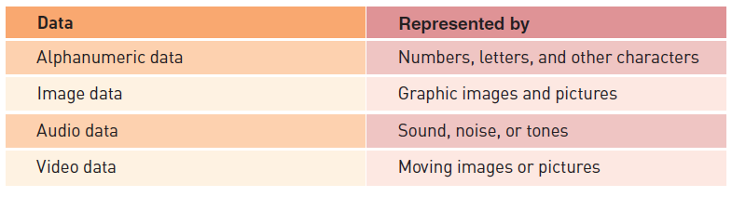

Data, Information, and Knowledge (continued)
Fundamentals of Information Systems, Sixth Edition

Slide 12
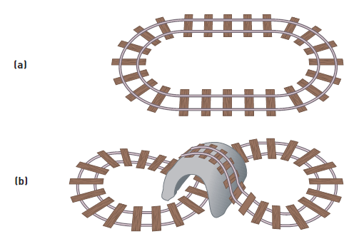
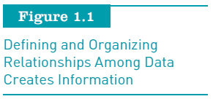
Data, Information, and Knowledge (continued)
Fundamentals of Information Systems, Sixth Edition

Slide 13
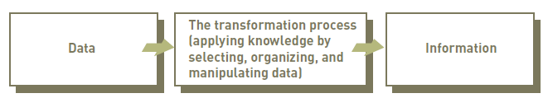
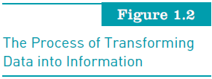
Data, Information, and Knowledge (continued)
Fundamentals of Information Systems, Sixth Edition

Slide 14
The Characteristics of Valuable Information
If an organization’s information is not accurate or complete:
  People can make poor decisions, costing thousands, or even millions, of dollars
Depending on the type of data you need:
  Some characteristics become more important than others
Fundamentals of Information Systems, Sixth Edition

Slide 15
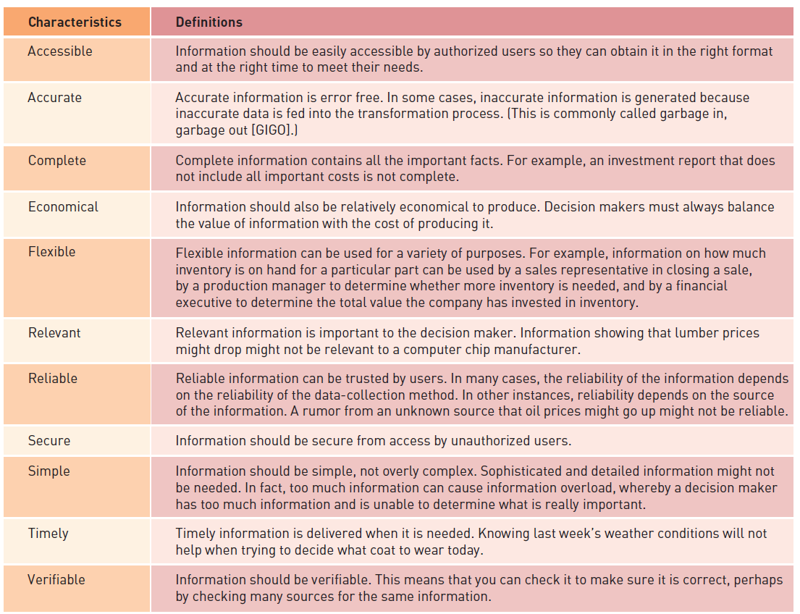
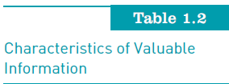
Fundamentals of Information Systems, Sixth Edition

Slide 16
The Value of Information
Directly linked to how it helps decision makers achieve their organization’s goals
Valuable information:
  Can help people and their organizations perform tasks more efficiently and effectively
Fundamentals of Information Systems, Sixth Edition

Slide 17
What is an Information System?
Information system (IS) is a set of interrelated elements that:
  Collect (input)
  Manipulate (process)
  Store
  Disseminate (output) data and information
  Provide a corrective reaction (feedback mechanism) to meet an objective
Fundamentals of Information Systems, Sixth Edition

Slide 18
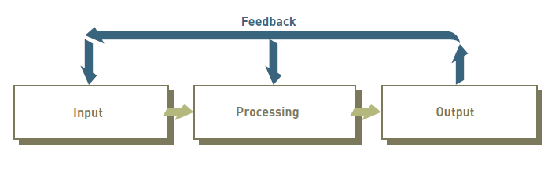
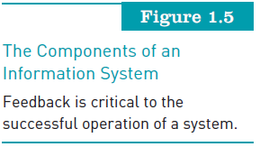
What is an Information System? (continued)
Fundamentals of Information Systems, Sixth Edition

Slide 19
Input, Processing, Output, Feedback
Input:
  Activity of gathering and capturing raw data
Processing:
  Converting data into useful outputs
Output:
  Production of useful information, usually in the form of documents and reports
Feedback:
  Information from the system that is used to make changes to input or processing activities
Fundamentals of Information Systems, Sixth Edition

Slide 20
Manual and Computerized Information Systems
An information system can be:
  Manual or computerized
Example:
  Investment analysts manually draw charts and trend lines to assist them in making investment decisions
Computerized information systems:
  Follow stock indexes and markets and suggest when large blocks of stocks should be purchased or sold
Fundamentals of Information Systems, Sixth Edition

Slide 21
Computer-Based Information Systems
Single set of hardware, software, databases, telecommunications, people, and procedures:
  That are configured to collect, manipulate, store, and process data into information
Technology infrastructure:
  Includes all hardware, software, databases, telecommunications, people, and procedures
    Configured to collect, manipulate, store, and process data into information
Fundamentals of Information Systems, Sixth Edition

Slide 22
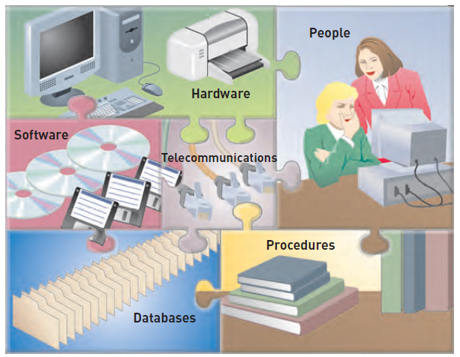
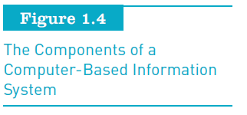
Computer-Based Information Systems (continued)
Fundamentals of Information Systems, Sixth Edition

Slide 23
Computer-Based Information Systems (continued)
Hardware:
  Consists of computer equipment used to perform input, processing, and output activities
Software:
  Consists of the computer programs that govern the operation of the computer
Database:
  Organized collection of facts and information, typically consisting of two or more related data files
Fundamentals of Information Systems, Sixth Edition

Slide 24
Computer-Based Information Systems (continued)
Telecommunications, networks, and the Internet:
  The electronic transmission of signals for communications
Networks:
  Connect computers and equipment to enable electronic communication
Internet:
  World’s largest computer network, consisting of thousands of interconnected networks, all freely exchanging information
Fundamentals of Information Systems, Sixth Edition

Slide 25
Computer-Based Information Systems (continued)
Intranet:
  Internal network that allows people within an organization to exchange information and work on projects
Extranet:
  Network that allows selected outsiders, such as business partners and customers, to access authorized resources of a company’s intranet
Fundamentals of Information Systems, Sixth Edition

Slide 26
Computer-Based Information Systems (continued)
People:
  The most important element in most computer-based information systems
Procedures:
  Include strategies, policies, methods, and rules for using the CBIS
Fundamentals of Information Systems, Sixth Edition

Slide 27
Business Information Systems
Most common types of information systems:
  Those designed for electronic and mobile commerce, transaction processing, management information, and decision support
Some organizations employ:
  Special-purpose systems, such as virtual reality, that not every organization uses
Fundamentals of Information Systems, Sixth Edition

Slide 28
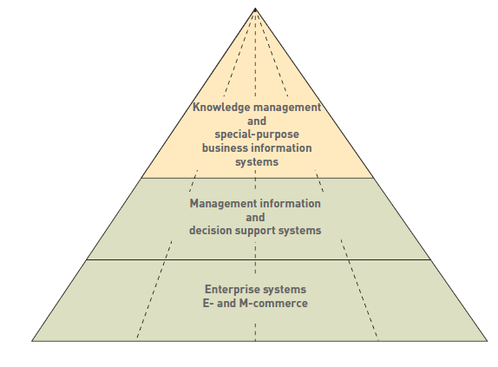
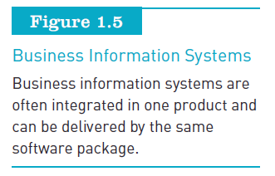
Business Information Systems (continued)
Fundamentals of Information Systems, Sixth Edition

Slide 29
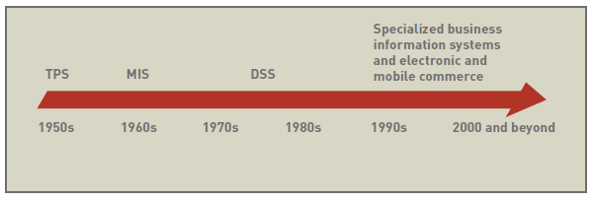
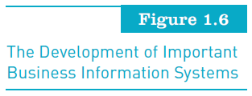
Business Information Systems (continued)
Fundamentals of Information Systems, Sixth Edition

Slide 30
Electronic and Mobile Commerce
E-commerce:
  Any business transaction executed electronically between:
    Companies (business-to-business, B2B)
    Companies and consumers (business-to-consumer, B2C)
    Consumers and other consumers (consumer-to-consumer, C2C)
    Business and the public sector
    Consumers and the public sector
Fundamentals of Information Systems, Sixth Edition

Slide 31
Electronic and Mobile Commerce (continued)
Mobile commerce (m-commerce):
  The use of mobile, wireless devices to place orders and conduct business
E-commerce:
  Can enhance a company’s stock prices and market value
Electronic business (e-business):
  Uses information systems and the Internet to perform all business-related tasks and functions
Fundamentals of Information Systems, Sixth Edition

Slide 32
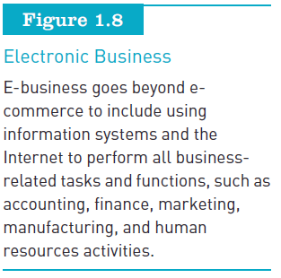
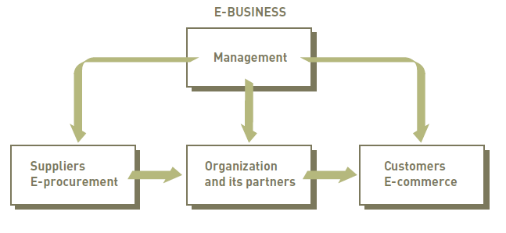
Electronic and Mobile Commerce (continued)
Fundamentals of Information Systems, Sixth Edition

Slide 33
Enterprise Systems: Transaction Processing Systems and Enterprise Resource Planning
Transaction:
  Any business-related exchange, such as payments to employees and sales to customers
Transaction processing system (TPS):
  Organized collection of people, procedures, software, databases, and devices used to record completed business transactions
Fundamentals of Information Systems, Sixth Edition

Slide 34
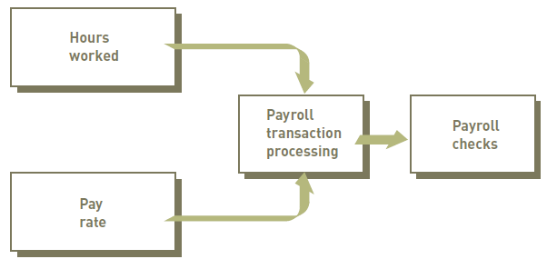
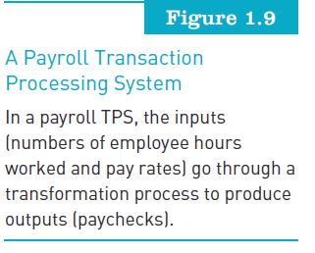
Enterprise Systems: Transaction Processing Systems and Enterprise Resource Planning (continued)
Fundamentals of Information Systems, Sixth Edition

Slide 35
Enterprise Systems: Transaction Processing Systems and Enterprise Resource Planning (continued)
Enterprise resource planning:
  Set of integrated programs that manages the vital business operations for an entire multisite, global organization
Fundamentals of Information Systems, Sixth Edition

Slide 36
Information and Decision Support Systems
Management information system (MIS):
  Organized collection of people, procedures, software, databases, and devices that provides routine information to managers and decision makers
Fundamentals of Information Systems, Sixth Edition

Slide 37
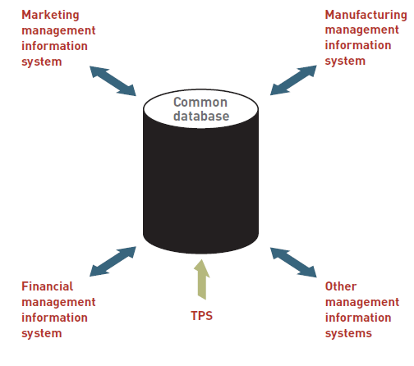
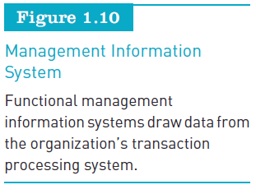
Information and Decision Support Systems (continued)
Fundamentals of Information Systems, Sixth Edition

Slide 38
Information and Decision Support Systems (continued)
Decision support system (DSS):
  Organized collection of people, procedures, software, databases, and devices that support problem-specific decision making
  Can include:
    A collection of models used to support a decision maker or user (model base)
    A collection of facts and information to assist in decision making (database)
    Systems and procedures (user interface or dialogue manager) that help decision makers and other users interact with the DSS
Fundamentals of Information Systems, Sixth Edition

Slide 39
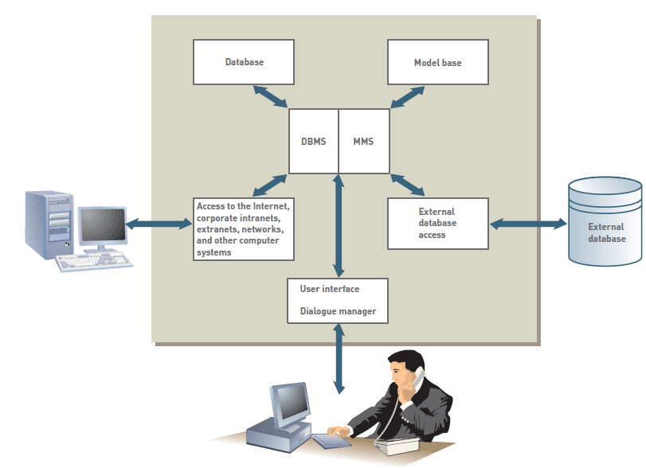

Information and Decision Support Systems (continued)
Fundamentals of Information Systems, Sixth Edition

Slide 40
Specialized Business Information Systems: Knowledge Management, Artificial Intelligence, Expert Systems, and Virtual Reality
Knowledge management systems (KMSs):
  Organized collection of people, procedures, software, databases, and devices to:
    Create, store, share, and use the organization’s knowledge and experience
Artificial intelligence (AI):
  Computer system takes on characteristics of human intelligence
Fundamentals of Information Systems, Sixth Edition

Slide 41
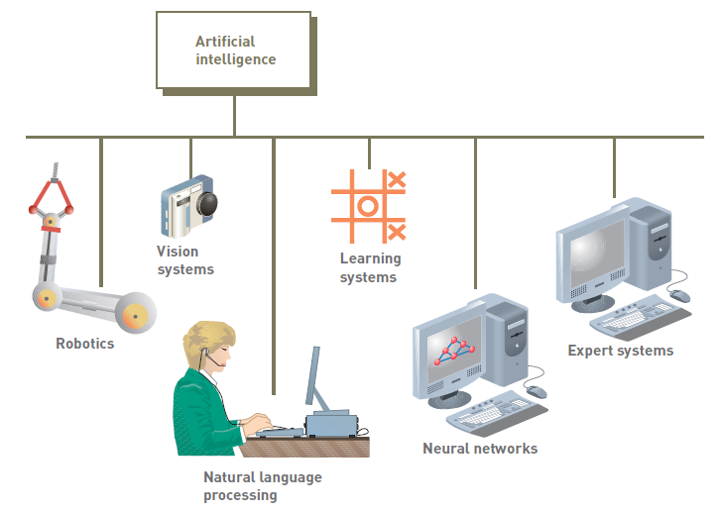
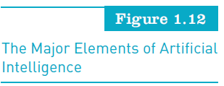
Specialized Business Information Systems (continued)
Fundamentals of Information Systems, Sixth Edition

Slide 42
Specialized Business Information Systems (continued)
Expert systems:
  Give computer ability to make suggestions and function like an expert in a particular field
Virtual reality and multimedia:
  Virtual reality:
    Simulation of a real or imagined environment that can be experienced visually in three dimensions
  Multimedia:
    Can include photos and images, the manipulation of sound, and special 3D effects
Fundamentals of Information Systems, Sixth Edition

Slide 43
Systems Development
Systems development:
  The activity of creating or modifying existing business systems
Outsourcing:
  Allows a company to focus on what it does best and delegate other functions to companies with expertise in systems development
Fundamentals of Information Systems, Sixth Edition

Slide 44
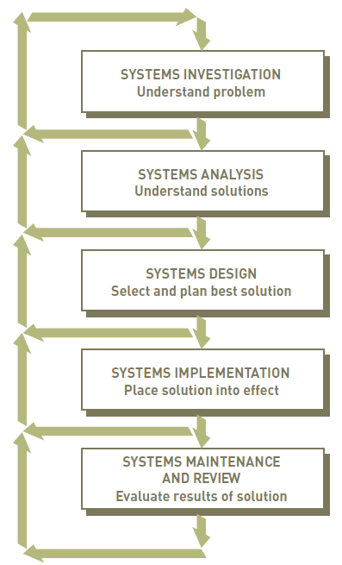
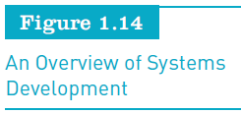
Systems Development (continued)
Fundamentals of Information Systems, Sixth Edition

Slide 45
Systems Investigation and Analysis
Goal of systems investigation:
  To gain clear understanding of the problem to be solved or opportunity to be addressed
Systems analysis:
  Defines the problems and opportunities of the existing system
Fundamentals of Information Systems, Sixth Edition

Slide 46
Systems Design, Implementation, and Maintenance and Review
Systems design:
  Determines how new system will work to meet business needs defined during systems analysis
Systems implementation:
  Acquiring various system components defined in design step, assembling them, and putting the new system into operation
Systems maintenance and review:
  Checks and modifies the system so that it continues to meet changing business needs
Fundamentals of Information Systems, Sixth Edition

Slide 47
Organizations and Information Systems
Organization:
  Formal collection of people and other resources established to accomplish a set of goals
  A system
  Constantly uses money, people, materials, machines and other equipment, data, information, and decisions
Fundamentals of Information Systems, Sixth Edition

Slide 48
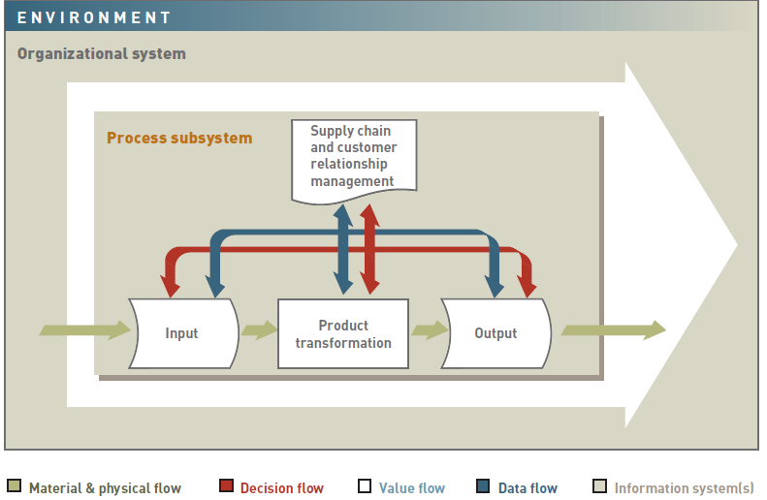
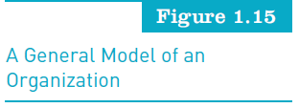
Organizations and Information Systems (continued)
Fundamentals of Information Systems, Sixth Edition

Slide 49
Organizations and Information Systems (continued)
Value chain:
  Series (chain) of activities that includes inbound logistics and warehouse and storage
Supply chain management (SCM):
  Determines:
    What supplies are required for value chain
    What quantities are needed to meet customer demand
    How supplies should be processed into finished goods and services
    How shipment of supplies and products to customers should be scheduled, monitored, and controlled
Fundamentals of Information Systems, Sixth Edition

Slide 50
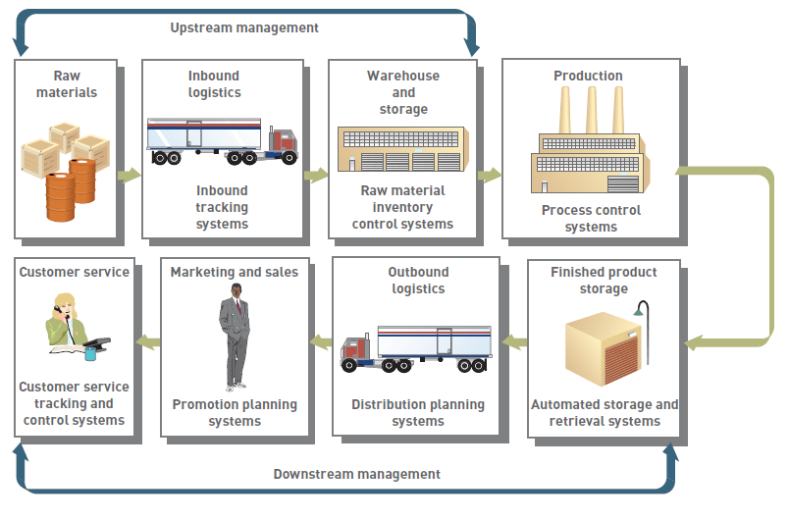
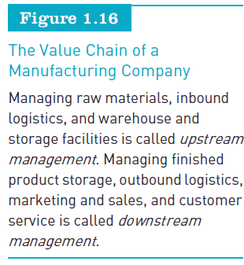
Organizations and Information Systems (continued)
Fundamentals of Information Systems, Sixth Edition

Slide 51
Organizations and Information Systems (continued)
Customer relationship management (CRM) programs:
  Help companies manage all aspects of customer encounters
  Can get customer feedback to help design new products and services
Fundamentals of Information Systems, Sixth Edition

Slide 52
Organizational Culture and Change
Culture:
  Set of major understandings and assumptions shared by a group
Organizational culture:
  Major understandings and assumptions
  Influences information systems
Organizational change:
  How organizations plan for, implement, and handle change
Fundamentals of Information Systems, Sixth Edition

Slide 53
User Satisfaction and Technology Acceptance
Technology acceptance model (TAM):
  Specifies the factors that can lead to better attitudes about the information system
Technology diffusion:
  Measure of how widely technology is spread throughout an organization
Technology infusion:
  Extent to which technology permeates a department
Fundamentals of Information Systems, Sixth Edition

Slide 54
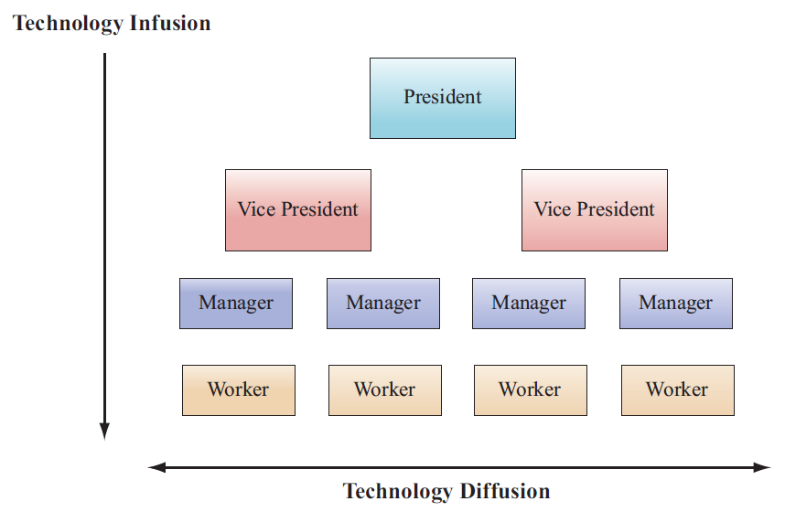
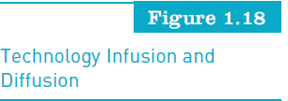
User Satisfaction and Technology Acceptance (continued)
Fundamentals of Information Systems, Sixth Edition

Slide 55
Competitive Advantage
Significant and (ideally) long-term benefit to a company over its competition
Can result in higher-quality products, better customer service, and lower costs
Fundamentals of Information Systems, Sixth Edition

Slide 56
Factors That Lead Firms to Seek Competitive Advantage
The five-forces model:
  Rivalry among existing competitors
  Threat of new entrants
  Threat of substitute products and services
  Bargaining power of buyers
  Bargaining power of suppliers
Fundamentals of Information Systems, Sixth Edition

Slide 57
Strategic Planning for Competitive Advantage
Strategies:
  Cost leadership
  Differentiation
  Niche strategy
  Altering the industry structure
  Creating new products and services
  Improving existing product lines and service
Fundamentals of Information Systems, Sixth Edition

Slide 58
Strategic Planning for Competitive Advantage (continued)
Other strategies:
  Growth in sales
  First to market
  Customizing products and services
  Hiring the best people
  Innovation
Fundamentals of Information Systems, Sixth Edition

Slide 59
Performance-Based Information Systems
Major stages in the use of information systems:
  Cost reduction and productivity
  Competitive advantage
  Performance-based management
Fundamentals of Information Systems, Sixth Edition

Slide 60
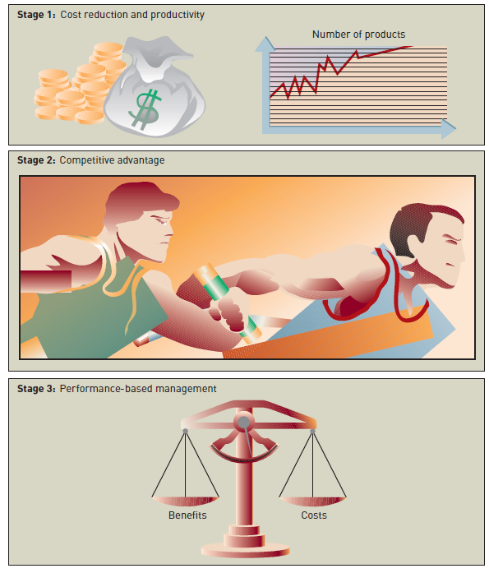
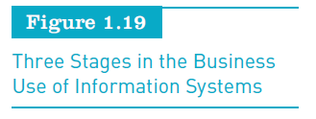
Fundamentals of Information Systems, Sixth Edition

Slide 61
Productivity
A measure of output achieved divided by input required
Higher level of output for a given level of input means greater productivity
Lower level of output for a given level of input means lower productivity
Productivity = (Output / Input) × 100%
Fundamentals of Information Systems, Sixth Edition

Slide 62
Return on Investment and the Value of Information Systems
Return on investment (ROI):
  One measure of IS value
  Investigates the additional profits or benefits that are generated as a percentage of the investment in IS technology
Earnings growth:
  The increase in profit that the system brings
Fundamentals of Information Systems, Sixth Edition

Slide 63
Return on Investment and the Value of Information Systems (continued)
Market share and speed to market:
  The percentage of sales that a product or service has in relation to the total market
Customer awareness and satisfaction:
  Performance measurement is based on feedback from internal and external users
Total cost of ownership:
  The sum of all costs over the life of the information system
Fundamentals of Information Systems, Sixth Edition

Slide 64
Risk
Managers must consider the risks of designing, developing, and implementing systems
Information systems can sometimes be costly failures
Fundamentals of Information Systems, Sixth Edition

Slide 65
Careers in Information Systems
Degree programs:
  Information systems
  Computer information systems
  Management information systems
U.S. Department of Labor’s Bureau of Labor Statistics (www.bls.gov):
  Predicts that many technology jobs will increase through 2012 or beyond
Fundamentals of Information Systems, Sixth Edition

Slide 66
Roles, Functions, and Careers in IS
Primary responsibilities in information systems:
  Operations:
    System operators primarily run and maintain IS equipment
  Systems development:
    Focuses on specific development projects and ongoing maintenance and review
Fundamentals of Information Systems, Sixth Edition

Slide 67
Roles, Functions, and Careers in IS
Primary responsibilities in information systems (continued):
  Support:
    Provides user assistance in hardware and software acquisition and use, data administration, user training and assistance, and Web administration
  Information service units:
    A miniature IS department attached and directly reporting to a functional area in a large organization
Fundamentals of Information Systems, Sixth Edition

Slide 68
Typical IS Titles and Functions
Chief information officer (CIO):
  Employs the IS department’s equipment and personnel to help the organization attain its goals
LAN administrators:
  Set up and manage the network hardware, software, and security processes
Fundamentals of Information Systems, Sixth Edition

Slide 69
Typical IS Titles and Functions (continued)
Internet careers:
  Internet strategists and administrators
  Internet systems developers
  Internet programmers
  Internet or Web site operators
Certification:
  Process for testing skills and knowledge resulting in an endorsement by the certifying authority
Fundamentals of Information Systems, Sixth Edition

Slide 70
Other IS Careers
New and exciting careers have developed in security and fraud detection and prevention
Other IS career opportunities include being employed by technology companies, such as:
  Microsoft (www.microsoft.com), Google (www.google.com), Dell (www.dell.com), and many others
Fundamentals of Information Systems, Sixth Edition

Slide 71
Working in Teams
It is always good for IS professionals to:
  Have good communications skills and the ability to work with other people
Getting the best team of IS personnel to work on important projects is:
  Critical in successfully developing new information systems or modifying existing ones
Fundamentals of Information Systems, Sixth Edition

Slide 72
Finding a Job in IS
Developing an online résumé can be critical to finding a good job
Job search approaches:
  On campus visits
  Referrals from professors, friends, and family members
  The Internet:
    Online job sites
    Company Web sites
    Social networking sites
    Blogs
Fundamentals of Information Systems, Sixth Edition

Slide 73
Global Challenges in Information Systems
Cultural challenges
Language challenges
Time and distance challenges
Infrastructure challenges
Currency challenges
Fundamentals of Information Systems, Sixth Edition

Slide 74
Global Challenges in Information Systems (continued)
Product and service challenges
Technology transfer issues
State, regional, and national laws
Trade agreements
Fundamentals of Information Systems, Sixth Edition

Slide 75
Summary
Data:
  Raw facts
To be valuable, information must be:
  Accurate, complete, economical to produce, flexible, reliable, relevant, simple to understand, timely, verifiable, accessible, and secure
Types of systems used within organizations:
  E-commerce and m-commerce, TPS and ERP, MIS and DSS, and specialized business information systems
Fundamentals of Information Systems, Sixth Edition

Slide 76
Summary (continued)
Systems development:
  The activity of creating or modifying existing business systems
Organization:
  Formal collection of people and various other resources established to accomplish a set of goals
Information systems personnel typically work in an IS department that employs:
  A chief information officer, systems analysts, computer programmers, and computer operators
Fundamentals of Information Systems, Sixth Edition

